Slide 1

Behavioural Biometrics

Slide 2
Introduction
Behavioral biometrics deals with active features for the purpose of biometric identification. These features change with time and are hence termed behavioral.
The basic philosophy of these systems is exactly the same as for the physiological biometric systems. Thus we follow the same principles of acquiring data, preprocessing and segmenting it, and then using the extracted features for recognition or verification with the help of classifiers.
Behavioral biometric systems use the concept of sampling as an additional step in their working. This means we need to decide certain sample frequency. Data are then captured at this particular frequency. Say the sample frequency decided is f Hz.
we study two very exciting systems: the speaker recognition system and the signature verification system. Both systems are extensively used in real-life applications. The former uses a very characteristic property of speech, which has been highly studied and developed.

Slide 3
Speech
Right from childhood, we hear so many sounds. We keep associating voices with actions, events, people, and so forth. As we grow up, we start learning the art of associating sounds with numerous things.
This learning gives us the very extraordinary power of perceiving things just by hearing. In turn, this means that speech is a very essential part of human life that many times conveys more that what sight can do. Speech holds so much information in itself, which helps us in various ways in our daily life.
For example, if someone coming from behind calls us, we can readily identify him by voice. Similarly if we chat with someone by phone, we are able to make many inferences, even though we have never seen the other person.
It is common for people to guess the sex, age, or even the mood of the other person by the way he or she speaks. Likewise, we are able to guess the singer of a song or say the voice of our faculty very easily. This all means that sound truly carries something very extraordinary in itself.

Slide 4
Speech
The problem here has been solved using two very common classifiers: artificial neural networks (ANN) with the back propagation algorithm (BPA) and adaptive neuro-fuzzy inference systems (ANFIS).
ANN with BPA has a very close resemblance to the human brain. Just as the brain can easily solve and perform the tasks that we wish to solve, ANN with BPA can do the same. In addition, as we have shown throughout this text.
ANN with BPA has great learning and generalizing powers, which again makes a very strong case for their use as classifiers. An easy way to visualize this system is in the form of rules. When a system tries to identify someone, it uses each and every characteristic, feature, and behavior of that person.
In this way, the system is related to a rule-based approach, in which the rules play a major role in mapping the input to the outputs. For this problem, we use neuro-fuzzy systems. These systems use ANN to train the fuzzy systems and are very useful if some of the system’s inputs and outputs as well as some of the rules are known.

Slide 5
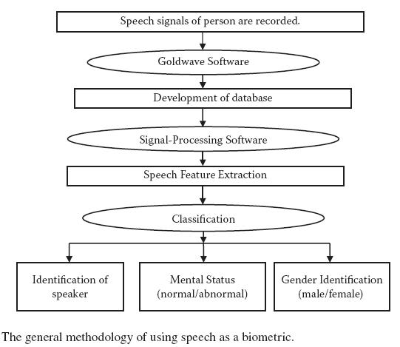
Speech
This section describes the results and findings of Shukla and Tiwari (2008c, 2008i, 2008m, 2007a, 2006), Shukla et al. (2008b, 2009e), and Agarwal, Prateek, et al. (2009).

Slide 6
Speech Input
Input is captured with the help of microphones and is then given to a computer that stores it in the form of a WAV file. The analog speech signal that comes from the microphone is digitized at a frequency of 16 KHz.
Nyquist criterion, which states that to avoid any loss of information, a signal must be sampled at a frequency that is double the bandwidth.
Remember that a very high sampling frequency would increase the file size and the processing time.
Once this recording has been made, it requires preprocessing and segmentation. In these steps, we remove noise from the recorded sample and extract the needed part from it.
Similarly, the silence between words and other such features must be cut. We use GoldWave software for these purposes.

Slide 7
Speech Features
In this step, we extract the relevant, or good, features from the speech signal. These features form the input for whichever classifier the system uses.
The following are the commonly extracted features for speech:
Maximum amplitude, or cepstral analysis
Peak and average power spectral density
Number of zero crossing (NZC)
Formant frequency
Time duration.
Pitch and pitch amplitude
We deal with some of these features below. Most of the features may be extracted using any signalprocessing tool and then be used straight away.

Slide 8

Cepstral Analysis
In this nonlinear signal-processing technique, we first apply the Fourier transformation to the signal sequence.
Then the real and complex logarithmics of the resulting signal are taken, followed by application of the inverse Fourier transformation.
In this analysis, we may be interested in the maximum amplitude of the signal that returns after the cepstral analysis to be used as a feature for recognition.

Slide 9
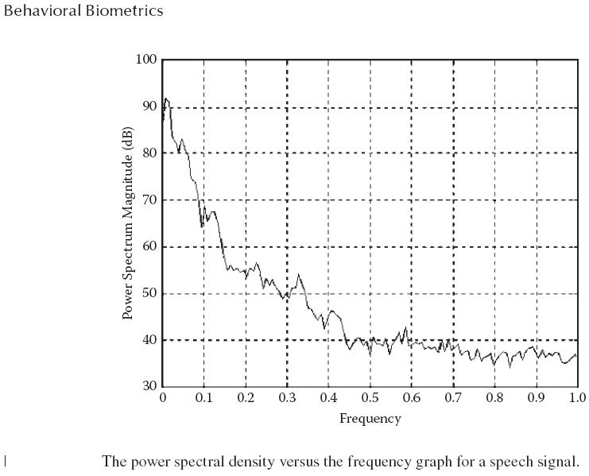
Power Spectral Density
Power spectral density (PSD) helps analyze the signal’s power or energy as a function of its frequency.
The PSD may be calculated in numerous ways. One of the ways is by the use of Welch Formula.

Slide 10
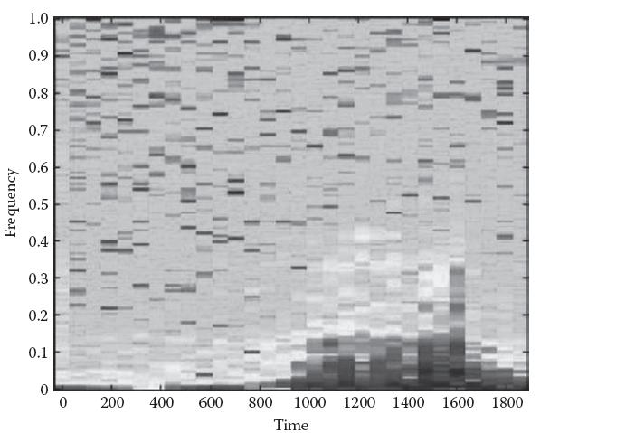
Spectrogram Analysis
This technique is used to analyze the signal’s spectral density with respect to the time. Here we use time-dependent analysis to study and analyze how the power per frequency varies with time.
For the sake of representation in a graph, it is represented by shades of gray.

Slide 11
Number of Zero Crossings
NZC denotes the number of times the signal crosses the x-axis (or the time axis). A crossing is defined as a change in amplitute from positive to negative or from negative to positive.
These crossing are calculated and used as features.
Formant Frequencies
The voice signal produced by each person always consists of a base frequency. This frequency is known as the fundamental frequency.
The resulting frequencies consist of a number of harmonics along with the base frequency. These harmonics are known as the formants.
T ime
In this case, this denotes the total time taken by the signal. For example, if the recording were of a person saying some word,
we would measure the total time the person takes to complete that word. Time is used as a direct feature for identification

Slide 12
Pitch and Amplitude
The pitch measures the signal’s frequency. We use Fourier analysis to measure the most dominant frequency.
Amplitude measures the signal’s height. We may use the maximum or the mean amplitude as features for this system.
Wavelet Analysis
In this section, we present another set of features that can be used for both identification and verification. We use wavelet analysis, which studies the entire signal and extracts a prespecified number of features called wavelet coefficients.
We also present two more similar analysis techniques—Fourier analysis and short-time Fourier analysis—that may be used in place of wavelet analysis for recognition purposes.

Slide 13
Fourier Analysis
This technique breaks down a signal into its constituent frequencies. A signal that was originally in the time domain is converted entirely into the frequency domain.
If we were to add all the frequencies returned by the Fourier analysis, we would get our original signal. The technique breaks up signal in order of their dominance in the given signal.
Because a Fourier analysis returns an infinite number of frequencies, we need to specify some threshold above which we will accept frequencies. This number is usually selected on the basis of the number of inputs our system can handle.
Hence in Fourier analysis, we break the given signal into a set of frequencies and select the major frequencies.
The signal is nearly reconstructed from these selected frequencies but without much loss of information. This makes Fourier analysis a good technique for feature extraction.

Slide 14
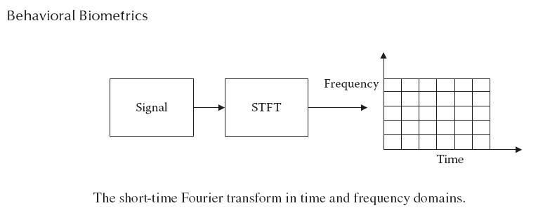
Fourier Analysis
However, Fourier analysis has a major drawback. While representing any signal in the frequency domain, we lose all the information about time, which is a major factor in a number of cases.
These short-duration behaviors include drift, trends, abrupt changes, and beginnings and ends of events.

Slide 15
Short-Time Fourier Analysis
Short-time Fourier analysis techniques solve the drawback that we discussed above in Fourier analysis.
With this type of analysis, we introduce some information about time in the analysis by specifying a window of a constant timeframe.
Fourier transform (STFT). Thus this type of analysis caters to the twin needs of frequency and time, with the frequency information being supplied within the windows of time.
The STFT approach fixes the time and frequency in such a way that the best information from both is obtained with the least loss of information.
A correct match between the time and frequency is required to ensure coverage of the maximum amount of information with the least number of coefficients.
Some regions may require a smaller window, while others may require a larger window. In such cases, it becomes difficult to optimize the system. Hence a fixed-size window often fails to cater to the needs of time and frequency and is thus a limitation with STFT.

Slide 16
Wavelet Analysis
Wavelet analysis improves the limitations of short-time Fourier analysis. In wavelet analysis, the size of the window can be kept variable.
In other words, the window is allowed to expand or collapse at different regions or different times of the signal.
In wavelet analysis, the signal is broken down during wavelet decomposition into approximation and detail.
That approximation may then be further broken down at the second level into approximation and detail. In this manner, the approximations continue to be broken down.
For n-level decomposition, there are n + 1 possible ways to decompose, or encode, the signal.

Slide 17
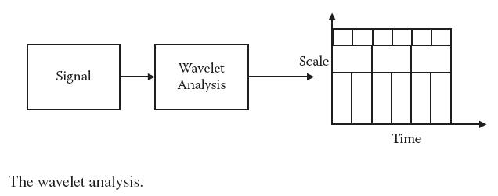
Wavelet Analysis
As this breaking down continues, the level of details increases, so that the details at later stages do not carry too much of importance as compared with the initial few details. T
herefore we must choose a threshold and stop the process of decomposition after this threshold is met. The decomposition is shown in Figure 8.6, in which S = A1 + D1 = (A2 + D2) + D1 = ((A3 + D3) + D2) + D1.

Slide 18
ANN with BPA
We have used ANN with BPA, modular neural network (MNN), and neuro-fuzzy systems for this task. In this section, we study the ANN with BPA.
The next two sections are devoted to the use of MNN and neuro-fuzzy systems.
For the tasks that deal with the prediction of age and so on, a single output predicts the needed output.
In this way, we can easily use ANN using either the classification or the functional prediction models. In either case, the inputs must be normalized before the system can use them to calculate the system.
For any classification problem, it is generally assumed that the data should be as close together as possible in the input space for the intraclass entities and as far apart as possible for the interclass entities.

Slide 19
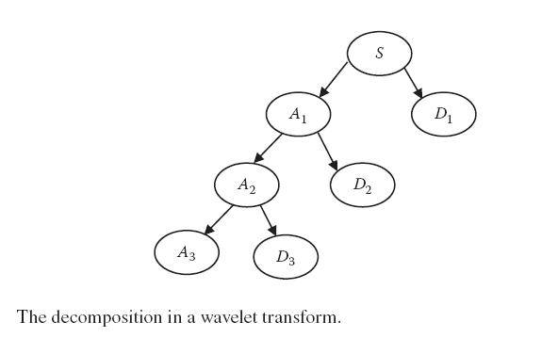
ANN with BPA
Any real-life problem has a high dimensionality that represents millions of possible options for various inputs. This high dimensionality puts a serious demand on the training data set to be rich and large.
As a result, we must work over the system with the help of available inputs in terms of both number and quality.
The ANN is further able to learn as much as possible with the limited test cases.

Slide 20
ANFIS
The second classifier and predictor we study here is the ANFIS, which is essentially a fuzzy system that is trained using an ANN learning procedure.
In this section, we spend time discussing the role and working of ANFIS in regard to practical real-life problems.
ANFIS provides an excellent means for tuning the resultant system and enabling it to match the available data set. This capability of ANFIS makes it an easy choice for use in many systems.
ANFIS is able to determine the rules starting from nothing. It first assumes an initial all-connected model that forms all possible input combinations in the generated membership functions.
The ability to use ANFIS without any initial idea of the rules works in numerous cases. We can easily understand why this is so if we look back to the previous section at our discussion of the practical uses of ANNs.

Slide 21
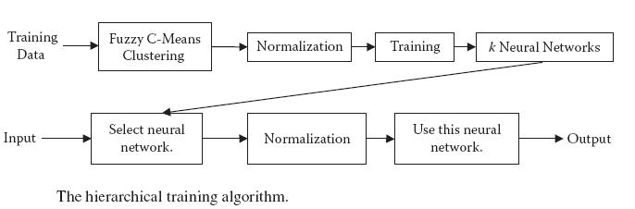
ANFIS
However, the problem of classification and functional prediction is in no way simple. Even though the outputs at a point may be influenced by the correct influencing forces, the problems of dimensionality and limited data size still exist.
Hence there are always constraints that make it difficult for the ANFIS to determine the effect of the rules at various places or the importance of those rules.

Slide 22
Modular Neural Network
The third kind of solution is obtained with the help of modified modular neural networks (MNNs). In many real-life applications, enormous research results in massive training data sets.
We again use a hierarchical model, in which the training data set is first clustered so that each cluster has its own ANN.
Unlike the MNNs, here we make use of fuzzy C-means clustering to classify the inputs and allot them the ANNs. This divides the entire input space clearly into regions and allots each region a distinct ANN.
Each ANN is trained independently using the members that belong to it, making it possible for the k ANNs to train simultaneously in parallel.
These inputs can be determined by a simple rule stating that every input chooses the ANN or cluster that is closest to it. During testing, whenever an input is given, the best cluster that is closest to the input is selected.

Slide 23
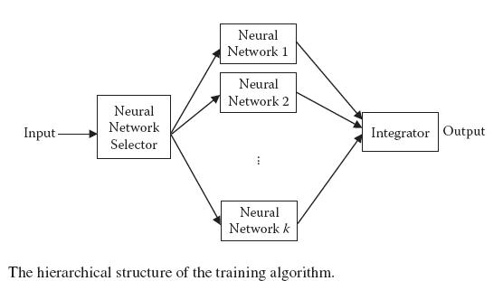
Modular Neural Network
The number of clusters or the number of ANNs, to be used in the MNN must be decided upfront. This value depends on the level to which we want the system to be distributed.
The generalizing is lost when we split the input space into multiple ANNs so that the ANNs are restricted to only a smaller region.
These factors must be accounted for when specifying the number of clusters, which determines the system’s efficiency and performance.

Slide 24
Systems and Results
We now know the various features and classifiers that may be used in any combination. We have also introduced the various problems that need to be solved.
To fully understand and get practical experience with real-life applications, let us choose the features and classifier to solve one of the problems.
ANN with BPA
We first develop an identification system by using ANN with BPA. We use the first set of discussed features, which include time duration, number of zero crossing, maximum cepstral, average power spectral density, pitch amplitude, pitch frequency, PSD, and four formant frequencies (F1 through F4).
After we are done identifying the speakers, we look at the problems of sex determination, identification of age group, and mental state.

Slide 25
ANN with BPA
First we look at the sex determination problem. In general, we observe that the formant frequencies are higher in females as compared with the males.
In peak PSD and average PSD, however, the reverse is true, with males having higher PSDs as compared with females. Maximum amplitude of a male speaker is higher than that of a female speaker.
The general analysis is first done on the attributes, revealing that the pitch frequency is higher for young speakers as compared with older speakers.
Average spectral density, peak spectral density, and maximum amplitude all increase with age; however, for people over 60 years, it is less.
The final experiment was identification of the speaker’s mental state. This is classified as either normal or abnormal. The speaker’s mental status is related to duration of pauses, pitch, formant frequency, amplitude, and time duration.

Slide 26
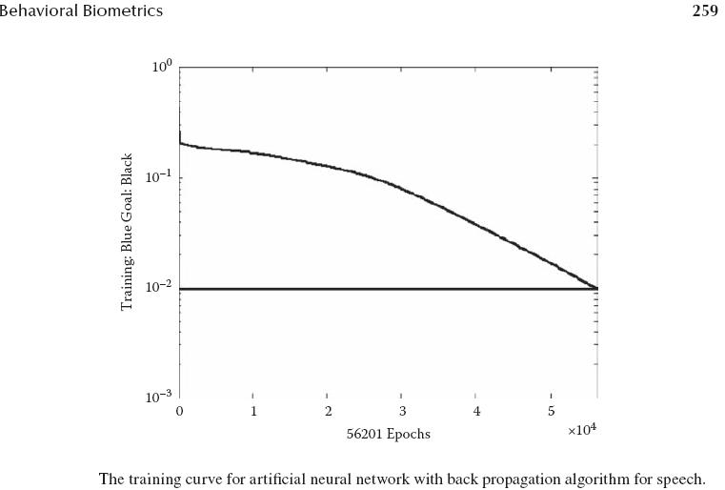
ANN with BPA

Slide 27
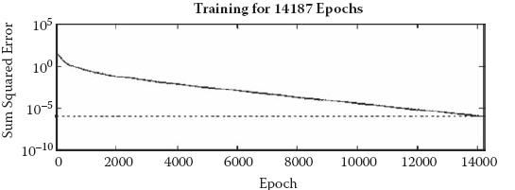
ANN with BPA
Maximum amplitude of an abnormal speaker is greater than that of a normal speaker. Duration of the utterance of the word for a normal speaker is very small as compared with an abnormal speaker.
In all the experiments of this example, we use the variable learning rule. ANN is trained for 50 speakers and tested on 50 speakers.
In all cases, the ANN was able to achieve high accuracies and thus solved the problem well. Hence we could use ANN with
BPA for the problems of sex determination, age group determination, mental state determination, and speaker authentication.

Slide 28
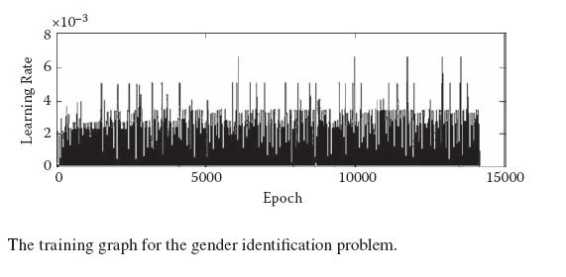
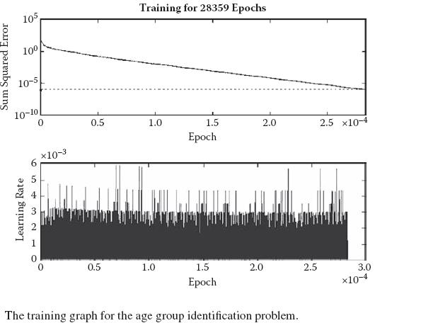
ANN with BPA

Slide 29
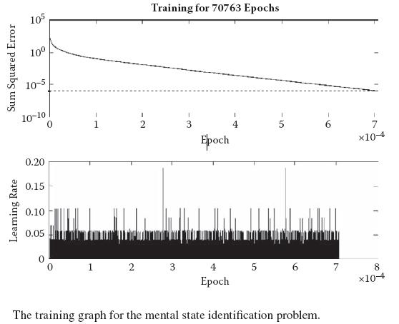
Neuro-Fuzzy System
The same set of features that we used in the earlier section is used in this system. For the development of the classifier, we use the ANFIS editor of MATLAB.

Slide 30
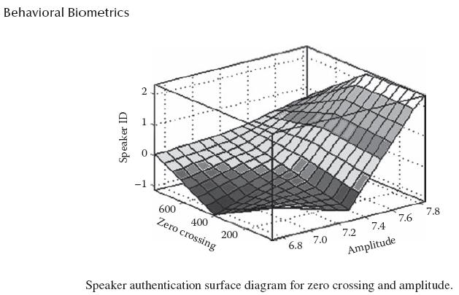
Neuro-Fuzzy System
In all the cases that we consider here, the model is tested for two cases: speaker independent and speaker dependent.

Slide 31
Neuro-Fuzzy System
The model is trained using some of the speech features of some of the speakers from the entire database of 50 speakers and using some words from the entire database of 36 words.
Then the system is tested for another set of speakers from the open and closed sets, depending on the case.
The first problem is of speaker identification. For this, we use four features: zero crossings, average PSD, amplitude, and pitch.
Case 1: Speaker-independent system (open set): The speech data used for testing the model is from the open set of ten speakers chosen at random. The output MF type is constant. The result shows that for Case 1, the recognition score varies from 80 percent to 100 percent and depends on the type of input MF.
To get a better recognition score, another attempt is then made using a different output MF type (linear), keeping the input membership function the same.

Slide 32
Neuro-Fuzzy System
Case 2: Speaker-dependent system (closed set): The speech data used for testing the ANFIS model is from a closed set of 10 speakers chosen at random. The model is configured for the input and output MF as used in Case 1.
Tables 8.4 and 8.5 show the details of the input function, epoch 20 error, average testing error, and efficiency for the training and testing data for the constant and linear output MF types.
Now we take the problem of sex determination, for which the factors are zero crossing, amplitude, average PSD, and pitch. The surface graph after training is shown in Figure 8.16.
For this problem, 0 represents male and 1 represents female. Thus a value less than 0.5 in testing signifies a male person, and vice versa. Again we have achieved an efficiency of 80 percent to 100 percent,

Slide 33
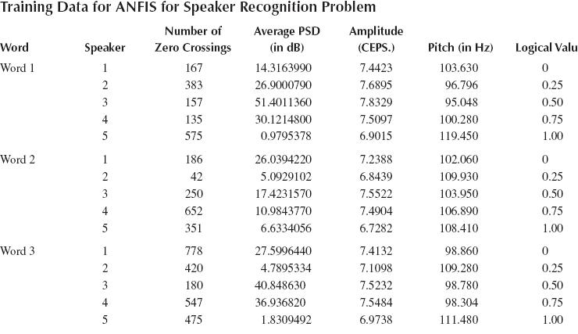
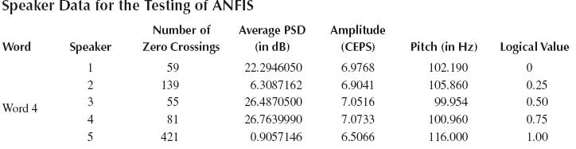
Neuro-Fuzzy System

Slide 34
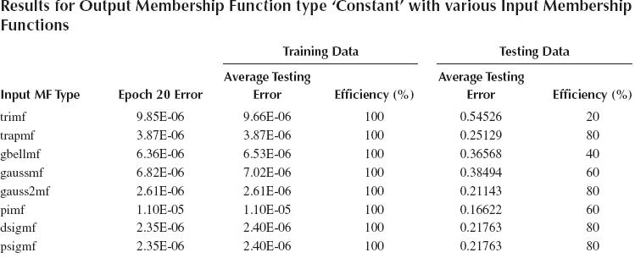
Neuro-Fuzzy System
depending on the membership function used.
The results for the speaker-independent and speakerdependent systems are shown in Figures 8.17a and 8.17b.

Slide 35
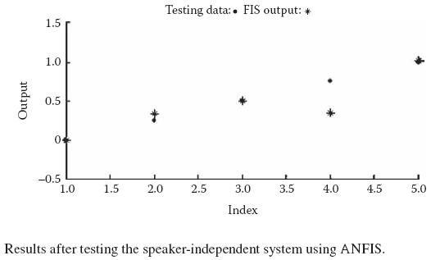
Modular Neural Networks
This system is able to recognize speakers when the data setconsists of words spoken in a variety of languages.
The sentence is worded in such a way that in each word, every consonant succeeds a vowel and vice versa.
The reason behind this is that whenever we pronounce any letter, a vowel sound is alway generated. A total of 904 words are recorded in 8 different Indian languages.
The efficiencies of single ANNs are given in Figure 8.19.

Slide 36
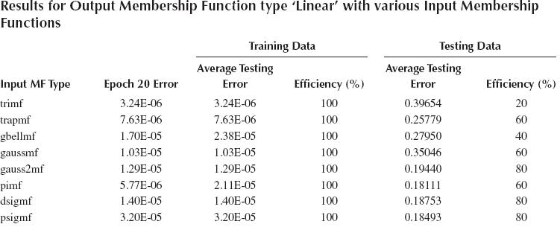
Modular Neural Networks
From the 20 clusters of 904 input data, the system’s average performance is 95.354 percent, with 42 errors. The resulting system solved the problem that a single ANN was unable to solve.
In addition, solving the problem took much less training time as compared with solving it using a single ANN. Hence it is clear that a single MNN is able to perform better and is able to solve the problem of multilingual speaker recognition.

Slide 37
Wavelet Coefficients with ANN and BPA
As our final experiment, we use the wavelet coefficients with ANN and BPA for the task of speaker recognition. We recorded data from 20 speakers who were asked to say five words each: “ab,” “is,” “baar,” “aap,” and
The number of levels was specified to be six, giving us six different values found from wavelet analysis. The results of some of the inputs of wavelet analysis are given in Table 8.7. The ANN had one hidden layer with 48 neurons in it. “apne.”
When the algorithm was executed on the collected data, we got a performance of 97.5 percent using 20 speakers and 40 test cases (39 correctly identified).
This clearly shows that the algorithm works well and gives correct results on almost all inputs.

Slide 38
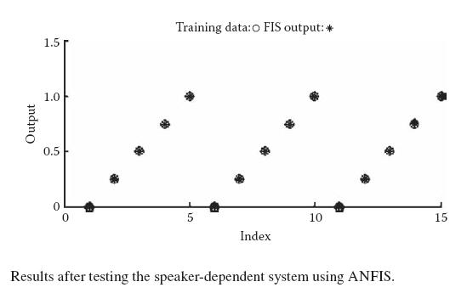
Wavelet Coefficients with ANN and BPA

Slide 39
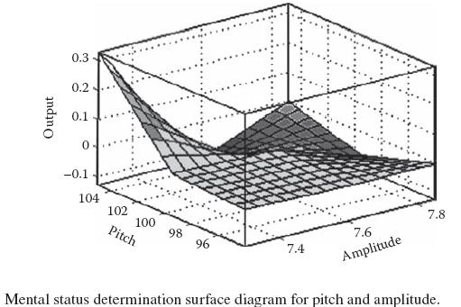
Wavelet Coefficients with ANN and BPA

Slide 40
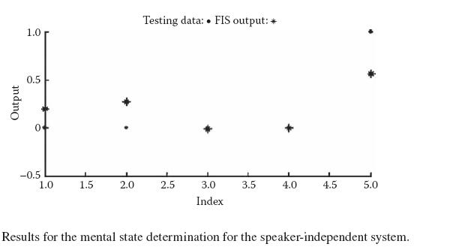
Wavelet Coefficients with ANN and BPA

Slide 41
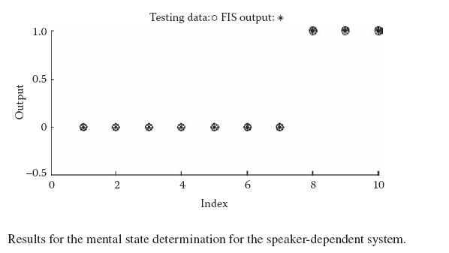
Wavelet Coefficients with ANN and BPA

Slide 42
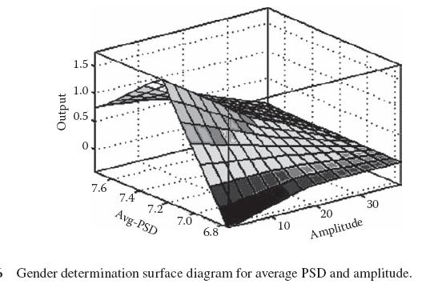
Wavelet Coefficients with ANN and BPA

Slide 43
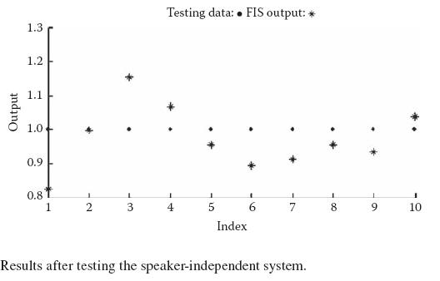
Wavelet Coefficients with ANN and BPA

Slide 44
Wavelet Coefficients with ANN and BPA

Slide 45
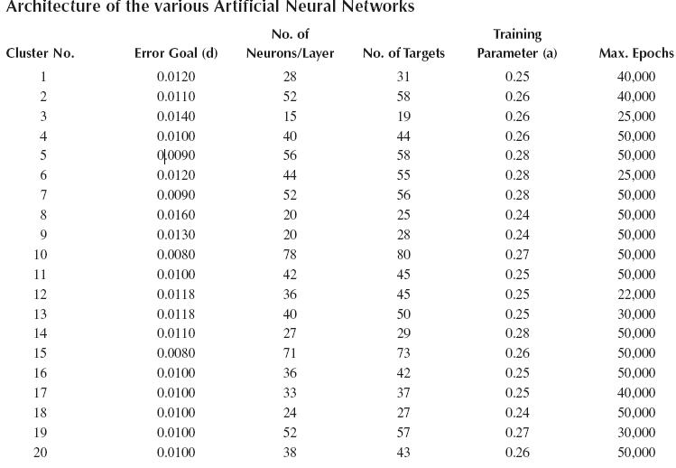
Wavelet Coefficients with ANN and BPA

Slide 46
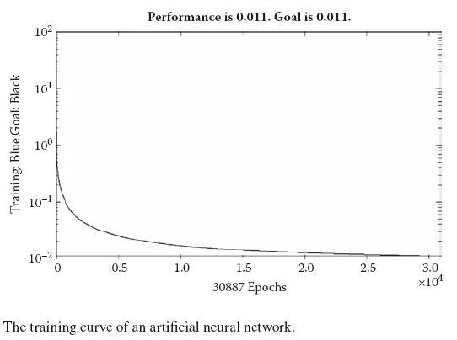
Wavelet Coefficients with ANN and BPA

Slide 47
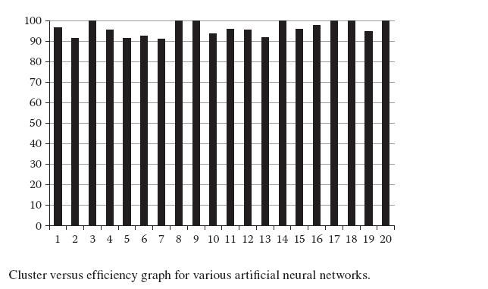
Wavelet Coefficients with ANN and BPA

Slide 48
Concluding Remarks for the Speech Biometric
In this section, we adopted a multidimensional approach toward problem solving with the biometric of speech. We first presented various features that could be extracted from speech.
At one end, we studied features such as number of zero crossings, PSD, and so forth. On the other end, we learned about the wavelet transform, STFT, and Fourier transform.
We then discussed the various classifiers that could be used for the problem, including ANN with BPA, neuro-fuzzy, and MNN. We also studied the various problems that can be solved using speech as a biometric, including speaker identification as well as age group, sex, and mental state.
In every case, we built a system that could effectively be used in real-life applications.

Slide 49
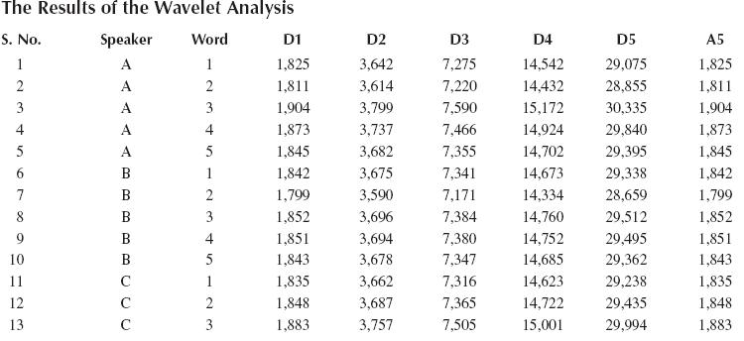
Concluding Remarks for the Speech Biometric

Slide 50
Signature Classification
Signature is the second biometric feature that we consider in this chapter. The use of signature for the authentication purposes is a very classic task. Signatures have evolved in such a way that they can be used as a written proof of something by some person.
Even today, signatures are used at all levels of organizations, departments, and institutions.
Thus the signature forms an integral part of the working of any society. For this reason, there is a need for systems that can identify and validate a person’s signature.
Signatures are another biometric known to be unique to every individual, which is why so many people use signatures for all major authentication systems
In particular, our signatures become very characteristic in nature because of the manner in which they are written. Our signatures denote the natural way in which we would write.
Experts are able to match signatures by noting the characteristic regions, the style of writing, the various curves and their locations, and so on.

Slide 51
Signature Classification
Signature recognition and verification are usually studied under two separate categories: offline and online. In the offline approach, the entire signature is available as an input to the system.
We have no idea of the manner in which the person signing made the signature. In other words, the person signs and then the signature is fed into the system.
The input typically consists of scanned images of the original signature. A common example of this technique is a person who signs a legal document and then sends it to someone else, who has to verify the signature.
In this case, the person would scan the document and send it as an input to the system for the purpose of verification.
Namely, the signature of the same person varies to very large extent from signing to signing. This difference may be due to mood, conditions, comfort, and so forth. In fact, a person signing

Slide 52
Signature Classification
two times, one right after the other, may make changes between signatures. This obviously creates a problem in the system.
This may be even more problematic than similar issues with face recognition, where we saw how various features that remain constant over region.
In general, the features of a signature are classified into two main groups.
The first group contains the global features, which describe or identify the signature as a whole (i.e., the global characteristics of the signature such as the width and the baseline). These global features are less sensitive to the effect of noise.
Finally, we briefly discuss classification, followed by the experimental results. Because image acquisition here is trivial and has already been discussed numerous times in this text, we do not cover it here.

Slide 53
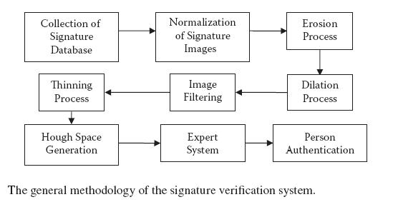
Signature Classification

Slide 54
Preprocessing
After image acquisition, the first step is to normalize the image to fix the range of all the values of the image pixels between 0 and 1.
The original image is shown in Figure 8.21a, while the normalized image is shown in Figure 8.21b.
Next we apply thresholding, or binarization, to make the entire image black and white.
All unconnected components are connected and all holes in the drawing are filled.
This step is also known as growing, boldening, and expansion. The image after erudition and dilation is shown in Figure 8.21d.
The final step is to detect the edges in the image. Figure 8.21e shows the image after edge detection.

Slide 55
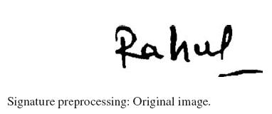
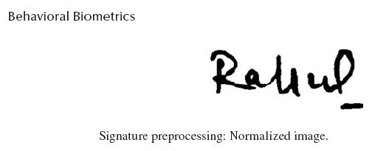
Preprocessing

Slide 56
Feature Extraction
In this problem, we use an analysis technique similar to Fourier and wavelet analysis for feature extraction. This technique is called the Hough transform.
The main objective is to represent the entire signature with as few coefficients and as little loss of information as possible for the sake of feature extraction or to limit the problem’s dimensionality.
The Hough transform represents the entire image or drawing vector in the form of coefficients. From these coefficients we may select the few best. Note that this transform works only for black-and-white images.
Any line is of the form y = mx + c. To avoid infinite values of m and for easy operation, we assume the line to be represented by p = x cos q + y cos q, where p is the perpendicular distance of the line from origin and q is the slope.
For each point in the graphic, we consider all the lines that go through the point at a particular angle q to be chosen a priori.

Slide 57
Feature Extraction
We calculate the distance d to the line through the point at angle q. This is repeated for a number of angle q that are discretized for computational purposes. The resulting distance d is also discretized.
This gives us points of the form (q, d), which are plotted in a space known as the Hough space. Because we have already made the axis of the Hough space discrete, we now get boxes, or accumulators, in this space.
These boxes accumulate the line possibilities and henc represent the density of the possibility of the lines at that angle and that distance. Ideally, for normally distributed data, the Hough space shows the Poisson ratio.
We then select the key points in the Hough space or lines in general. The Hough space for one of the inputs in the signature problem is shown in Figure 8.22.
The bigger white boxes denote the region where the value was found to be greater than normal. Some extracted matrix values from the Hough space are given in Table 8.8.

Slide 58
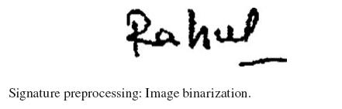
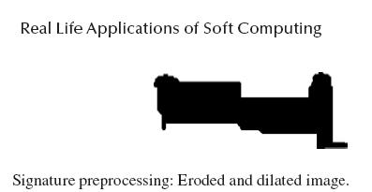
Artificial Neural Network
In the signature problem, we again used the ANN with BPA for the task of classification. This system takes as its input the extracted features from the previous step and assigns the output the degree of certainty associated with each input.
This role of ANN with BPA has already been discussed numerous times in the text; therefore we avoid discussing it here.

Slide 59
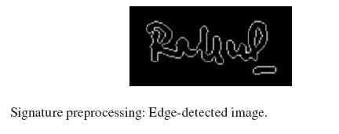
Artificial Neural Network

Slide 60
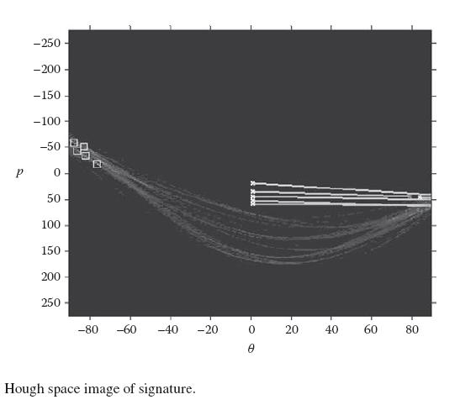
Artificial Neural Network

Slide 61
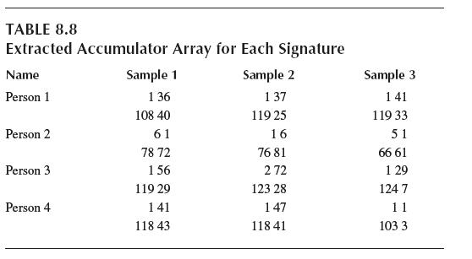
Artificial Neural Network

Slide 62
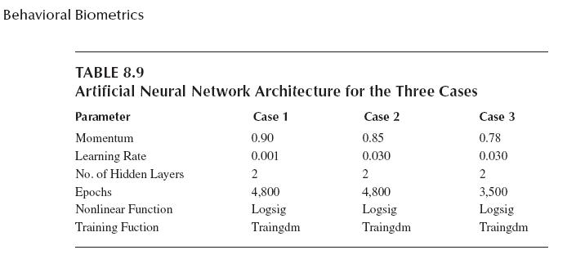
Artificial Neural Network

Slide 63
Artificial Neural Network
In the first case, the same signatures were used for training and testing purposes. Each training and testing consisted of 150 images. In the second case, the data for training exceeded the data for testing, with 150 images for the former and only 120 for the latter.
In the third case, we had fewer training data than testing data—100 images for training and 120 for testing.
The system was trained with BPA. The ANN architecture for the various cases is given in Table 8.9. Figures 8.23a, 8.23b, and 8.23c show the training curves of the three cases.
The system’s FRR was found to be 0.1, while the FAR was 0.17. The system’s efficiency for Case 1 was 99.87 percent; for Case 2, 97.56 percent; and for Case 3, 95.81 percent.

Slide 64
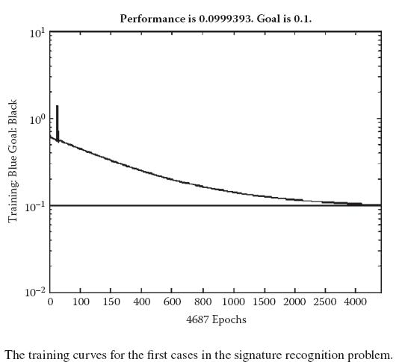
Concluding Remarks for the Signature Biometric
In this section, we used the Hough transform along with ANN and BPA for the purpose of user verification. In most cases, we were able to verify the correct identity of the person; hence the Hough 10 0

Slide 65
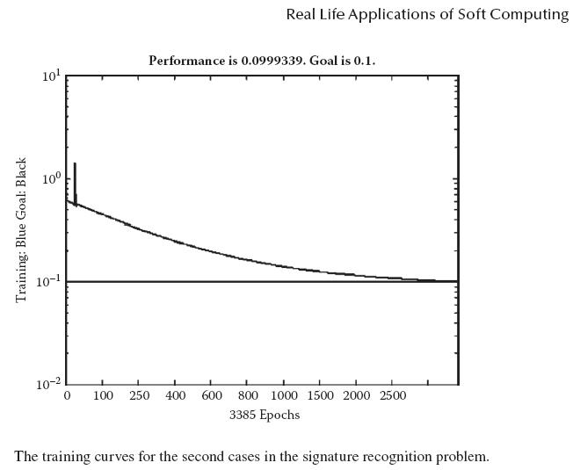
Concluding Remarks for the Signature Biometric

Slide 66
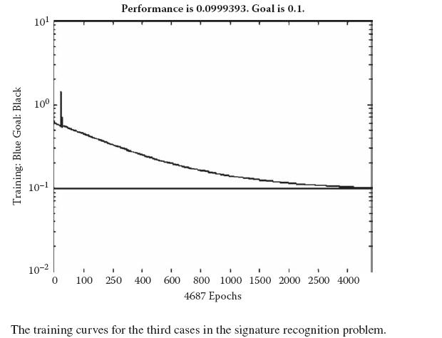
Concluding Remarks for the Signature Biometric
In addition, ANN with BPA acted as a good classifier to solve the problem and hence helped in the verification.
In addition, combining handwriting parameters with signature parameters can make a much better system.

